Slide 1
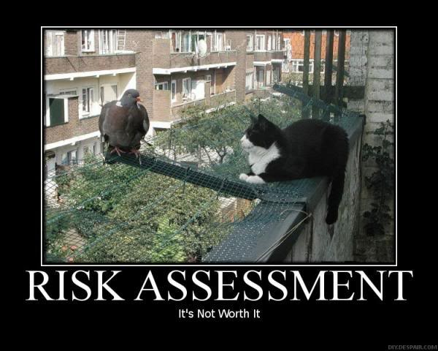

Risk Management Standard
Kitman Yiu
Teacher : Eric

Slide 2
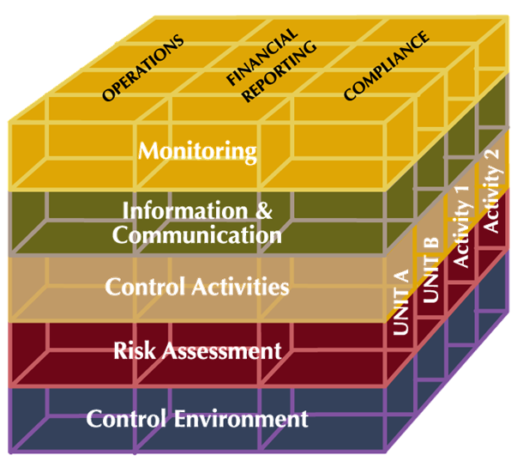
COSO Integrated Framework

Slide 3
History
Goal
Elements
Strengths and weaknesses
An example to apply to games development

Slide 4
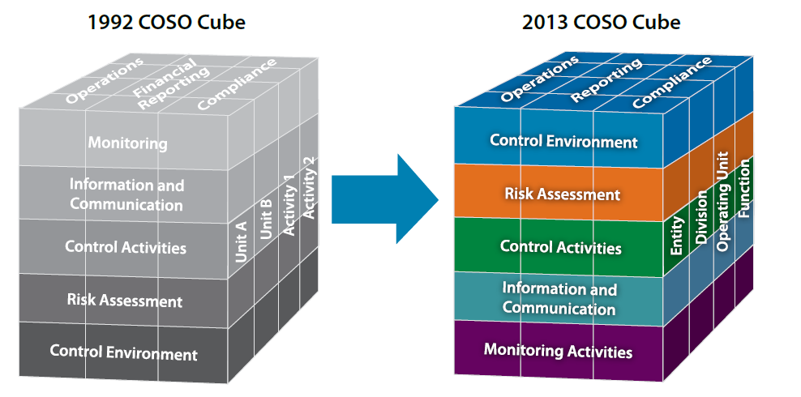
History
1985
Organized in 1985 establish by 5 groups
Robert Hirth Chairman
1992
COSO Internal Control Intergrated Framework 1992
2013
Publish new model because of change of technology and environments .

Slide 5
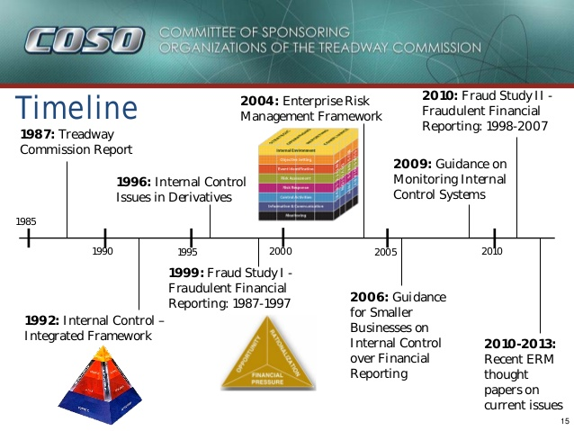
History Timeline

Slide 6
History_Changes
7 Changes that I found

Slide 7
History1

Slide 8
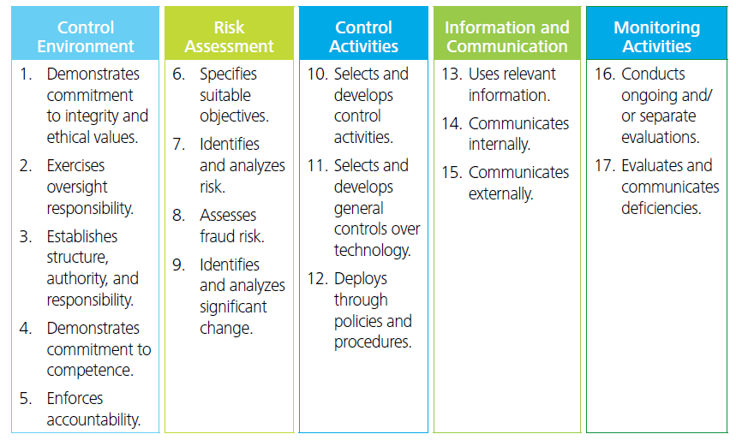
History2
Added 17 principles

Slide 9
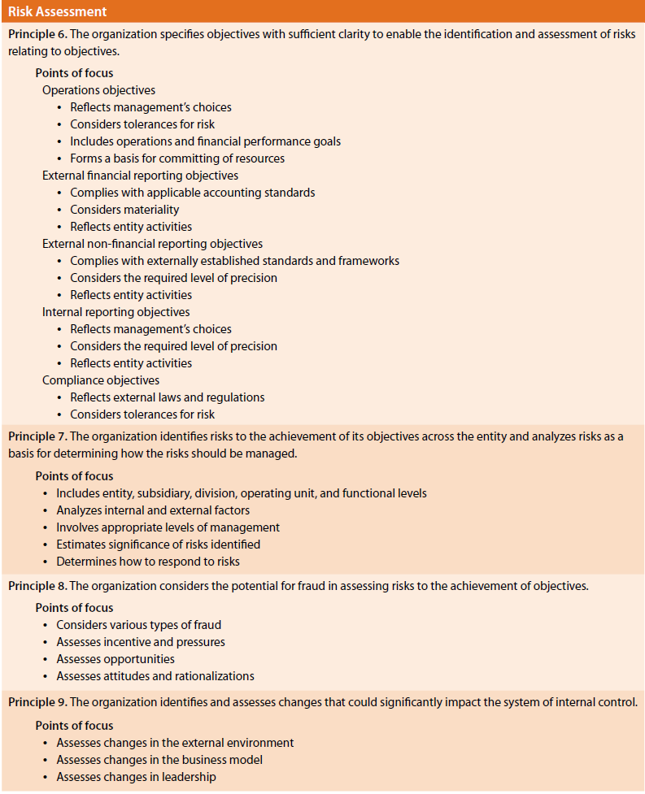
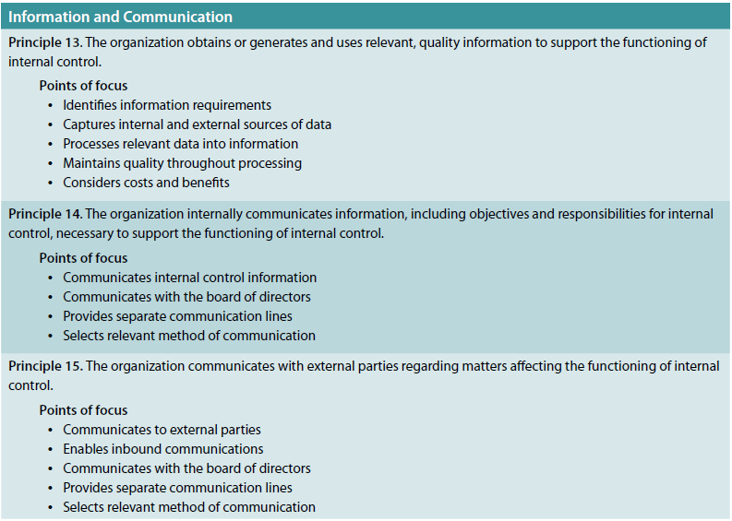
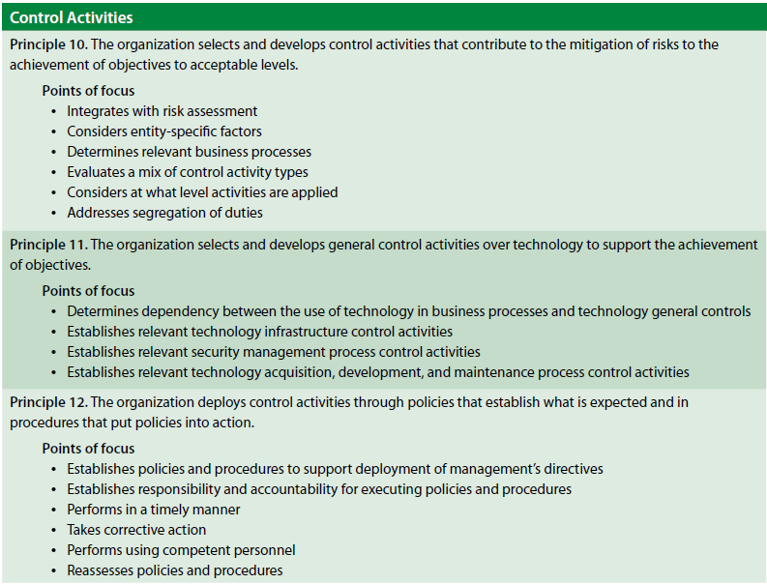
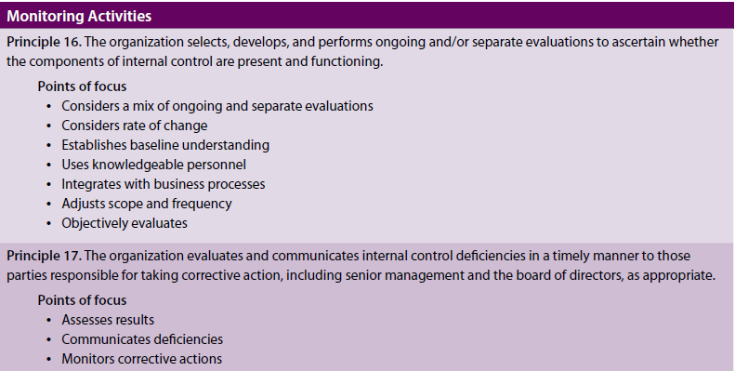
History3
Introduces 81 points(17 principles)

Slide 10
History 4,5,6,7
Scalability for smaller entities and governments
COSO’s goal updated to reflect changes in the business and operating environments
Defined what is Internal control
Retain 5 components but definitions have been expanded

Slide 11
Relationship between Risk Management and COSO - Internal Control 1
(IC)It will help to achieve its performance and profitability targets , so it will prevent loss of resources. It can also ensure financial reporting is reliable and ensure that companies comply with applicable laws and regulations, to avoid damage to its reputation and other consequences.

Slide 12
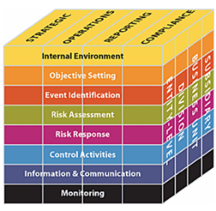
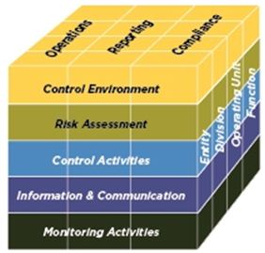
Relationship between Risk Management and COSO - Internal Control 2
(COSO ERM FAQ’s)
Separate
Neither supersedes
Encompasses
Incorporates
Compatible
Interrelationship
Broader then IC
Internal Control Framework
ERM Framework

Slide 13
Relationship between Risk Management and COSO - Internal Control 3
Enterprise risk management
(COSO ERM FAQ’s)Is a process, effected by the entity’s board of directors, management, and other personnel, applied in strategy setting and across the enterprise, designed to identify potential events that may affect the entity, and manage risk to be within the risk appetite, to provide reasonable assurance regarding the
achievement of objectives
Internal control
(IC)Is a process, effected by an entity’s board of directors, management and other personnel, designed to provide reasonable assurance regarding the achievement of objectives to operations , reporting and compliance.
Internal Control Framework
ERM Framework

Slide 14
Goal of Framework
(IC)COSO believes the Framework will enable organizations to effectively and efficiently develop and maintain systems of internal control that can enhance the likelihood of achieving the entity’s objectives and adapt to changes in the business and operating environments.

Slide 15
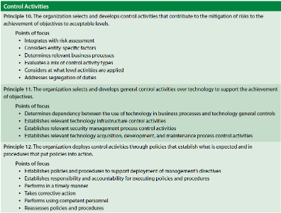
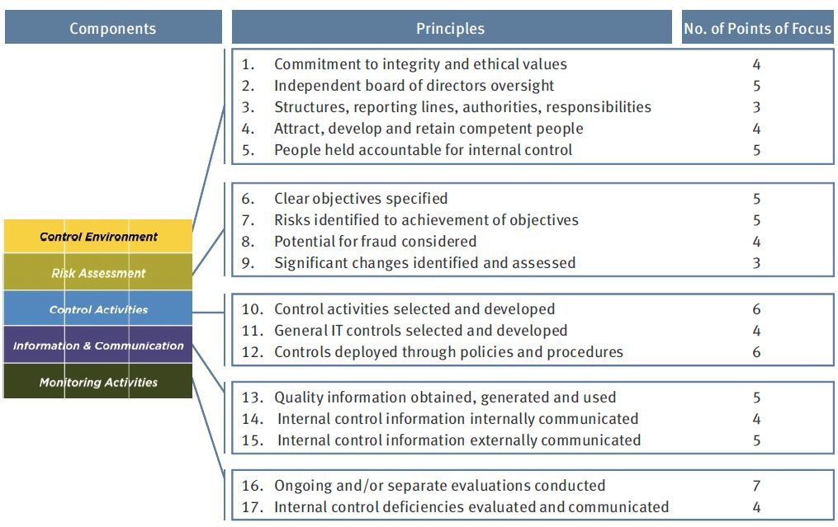
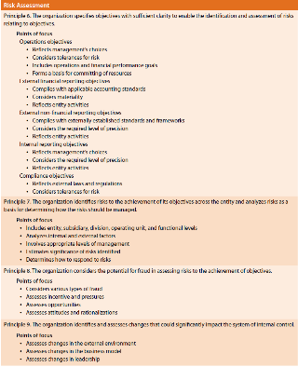
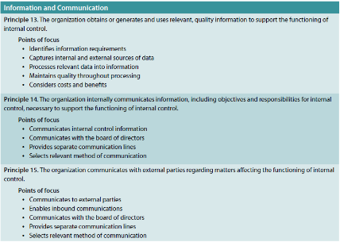
Overall image

Slide 16
Internal Control
(IC)Internal control is a process, effected by an entity’s board of directors, management and other personnel, designed to provide reasonable assurance regarding the achievement of objectives to operations , reporting and compliance.
OBJECTIVES

Slide 17
Operations
(IC)These pertain to effectiveness and efficiency of the entity’s operations, including operational and financial performance goals, and safeguarding assets against loss.

Slide 18
Reporting
(IC)These pertain to internal and external financial and non-financial reporting and may encompass reliability, timeliness, transparency, or other terms as set forth by regulators, standard setters, or the entity’s policies.

Slide 19
Compliance
(IC)These pertain to adherence to laws and regulations to which the entity is subject.

Slide 20
Major Components
Components

Slide 21
Control Environment
(IC)The control environment is the set of standards, processes, and structures that provide the basis for carrying out internal control across the organization. The board of directors and senior management establish the tone at the top regarding the importance of internal control including expected standards of conduct. Management reinforces expectations at the various levels of the organization. …..

Slide 22
Risk Assessment
(IC)Every entity faces a variety of risks from external and internal sources. Risk is defined as the possibility that an event will occur and adversely affect the achievement of objectives. Risk assessment involves a dynamic and iterative process for identifying and assessing risks to the achievement of objectives. Risks to the achievement of these objectives from across the entity are considered relative to established risk tolerances. Thus, risk assessment forms the basis for determining how risks will be managed.

Slide 23
Control Activities
(IC)Control activities are the actions established through policies and procedures that help ensure that management’s directives to mitigate risks to the achievement of objectives are carried out.
(IC)Control activities can support one or more of the entity’s operations, reporting, and compliance objectives. For example, an online retailer’s controls over the security of its information technology affect the processing of accurate and valid transactions with consumers, the protection of consumers’ confidential credit card information, and the availability and security of its website. In this case, control activities are necessary to support the reporting, compliance, and operations objectives

Slide 24
Information and Communication
(IC)Information is necessary for the entity to carry out internal control responsibilities to support the achievement of its objectives. Management obtains or generates and uses relevant and quality information from both internal and external sources to support the functioning of other components of internal control. Communication is the continual, iterative process of providing, sharing, and obtaining necessary information. Internal communication is the means by which information is disseminated throughout the organization, flowing up, down, and across the entity. It enables personnel to receive a clear message from senior management that control responsibilities must be taken seriously. External communication is twofold: it enables inbound communication of relevant external information, and it provides information to external parties in response to requirements and expectations.

Slide 25
Monitoring Activities
(IC)Ongoing evaluations, separate evaluations, or some combination of the two are used to ascertain whether each of the five components of internal control, including controls to effect the principles within each component, is present and functioning. Ongoing evaluations, built into business processes at different levels of the entity, provide timely information. Separate evaluations, conducted periodically, will vary in scope and frequency depending on assessment of risks, effectiveness of ongoing evaluations, and other management considerations. Findings are evaluated against criteria established by regulators, recognized standard-setting bodies or management and the board of directors, and deficiencies are communicated to management and the board of directors as appropriate.

Slide 26
Relationship of Objectives and Components
(IC)A direct relationship exists between objectives, which are what an entity strives to achieve, components, which represent what is required to achieve the objectives, and the organizational structure of the entity (the operating units, legal entities, and other). The relationship can be depicted in the form of a cube.
Objectives
Components

Slide 27
Organization
(IC)Allowing you to consider internal controls from an entity, divisional, operating unit, and/or functional level, such as for a shared services center
Organization

Slide 28
Relationship 1

Slide 29
Relationship 2

Slide 30
Strengths and weaknesses 1
Strength
Has been provide that it worked for a lot companies

Slide 31
Strengths and weaknesses 2
Weaknesses
Still will affected by limitations inherent in all systems of internal control
Controls can be circumvented by two or more people colluding, and because management can override the system of internal control
The first set of limitations acknowledges that certain events or conditions are simply beyond management’s control
The second acknowledges that no system of internal control will always do what it is designed to do.
internal control cannot provide absolute assurance for any of the objective categories

Slide 32
Example of Applying the game development
Management Department
EA Games
Design Department
Marketing Department

Slide 33
Overview of Integrated Framework. 2015. . [ONLINE] Available at:http://mcgladrey.com/content/dam/mcgladrey/pdf/wp_coso_2013_internal_control_integrated_framework.pdf. [Accessed 12 March 2015].
Integrated Framework. 2015. . [ONLINE] Available at:http://www.kpmg.com/Ca/en/External%20Documents/Final-New-COSO-2013-Framework-WHITEPAPER-web.pdf. [Accessed 12 March 2015].
IC. 2015. IC. [ONLINE] Available at: http://www.coso.org/IC.htm. [Accessed 12 March 2015].
COSO Framework & SoxCompliance. 2015. [ONLINE]. [ONLINE] Available at:http://www.coso.org/documents/COSO%20McNallyTransition%20Article-Final%20COSO%20Version%20Proof_5-31-13.pdf. [Accessed 12 March 2015].
COSO ERM FAQ’s. 2015. . [ONLINE] Available at: http://www.coso.org/documents/ERM-FAQs.pdf. [Accessed 12 March 2015].
ERM Framework. 2015. . [ONLINE] Available at:http://www.coso.org/documents/Framework%20Reference%20Secured.pdf. [Accessed 12 March 2015].
Control Activities Component. 2015. Control Activities Component. [ONLINE] Available at:http://www.controlsframework.com/control_activities.php. [Accessed 12 March 2015].

Slide 34
Thank you

